Slide 1
Deploy to Mars with Lando
Aaron Feledy
Arrow One Solutions

Slide 2
What is Lando?
Local Development and DevOps Tool
Mimic your production environment locally
Standardize your team's dev environments across platforms
Integrates with hosting providers
Customize or extend tooling, deployment options
Run CI tests locally, run local tests in CI
Use a single local development environment for all your projects
Notes:
It's a free, open source, cross-platform, local development environment and DevOps tool built on Docker container technology.

Slide 3
Xdebug
Step through code during execution
Get real time values for variables
Stack traces
Lots of overhead
Slows Drupal significantly
Requires Lando Rebuild when turning on or off

Slide 4
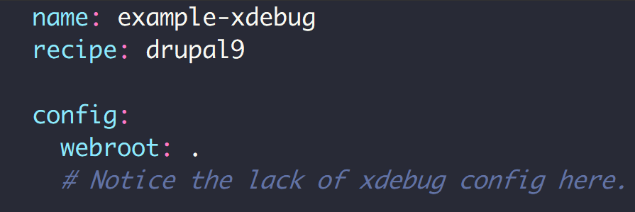
.lando.yml

Slide 5
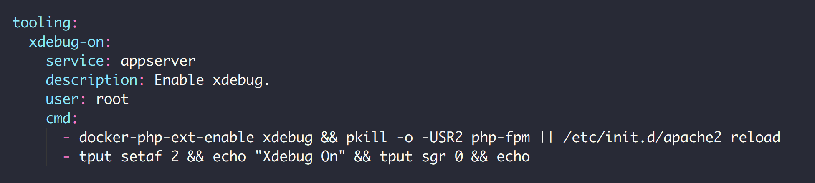
.lando.yml

Slide 6
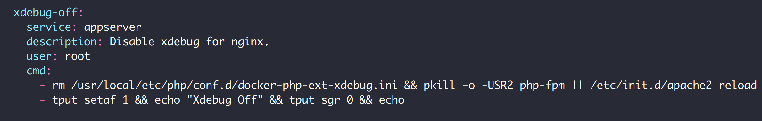
.lando.yml

Slide 7
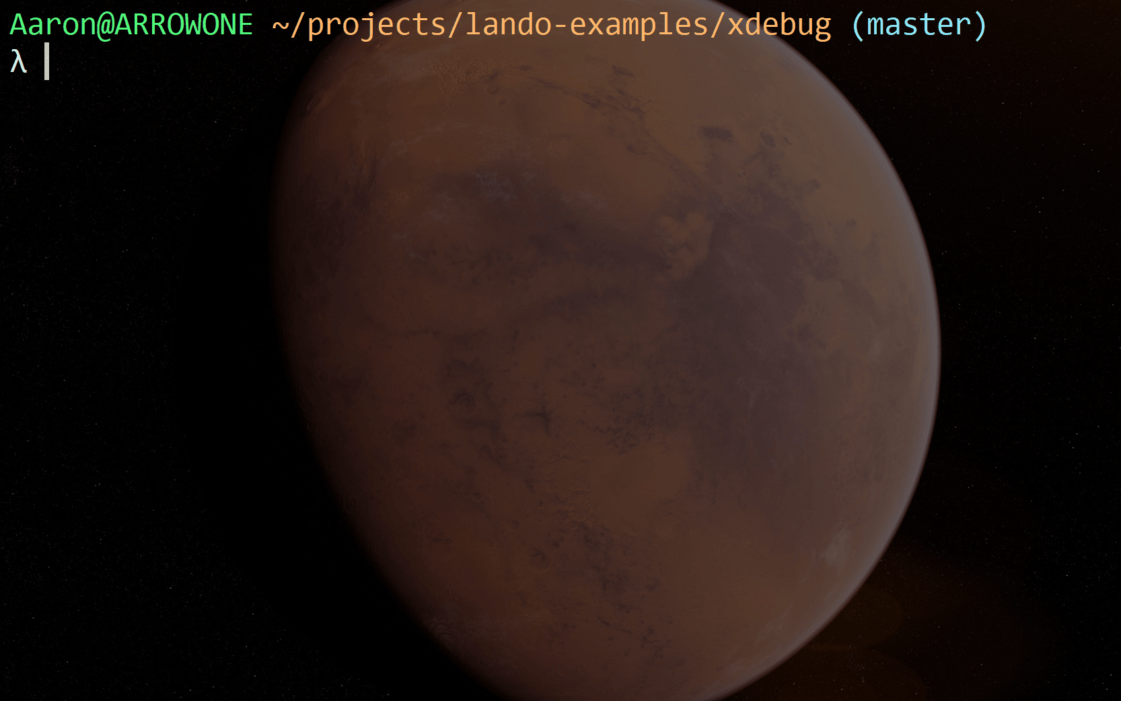

Slide 8
Decoupled
Separation of concerns
More complex environment
Multiple services
Targeted tooling
Interconnectivity

Slide 9
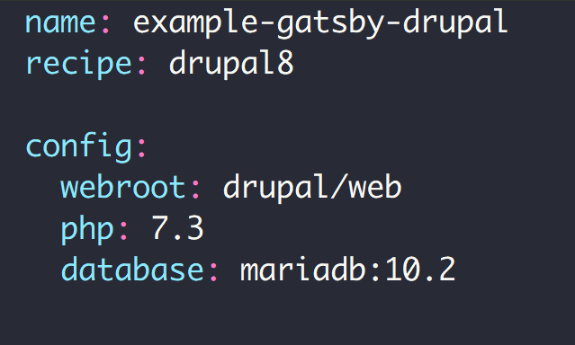
.lando.yml

Slide 10
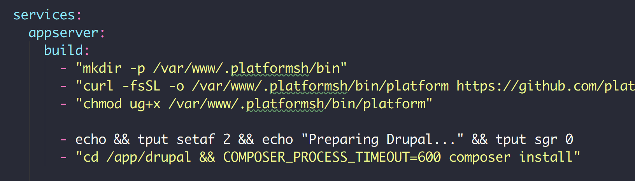
.lando.yml

Slide 11
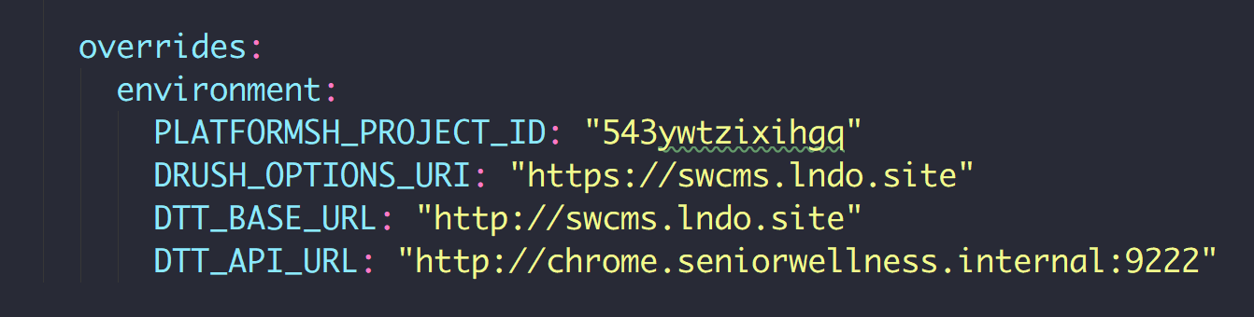
.lando.yml

Slide 12
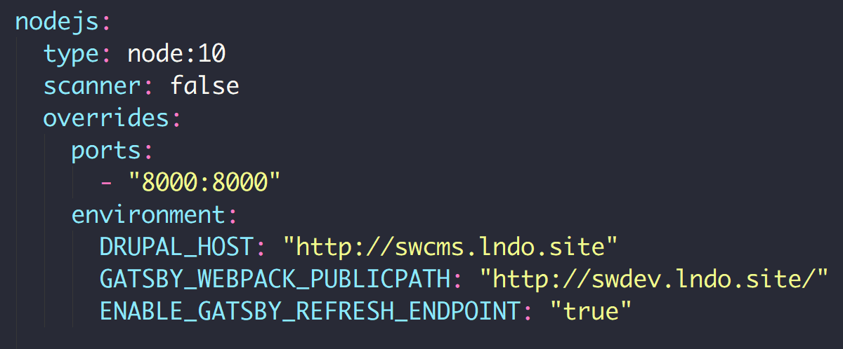
.lando.yml

Slide 13
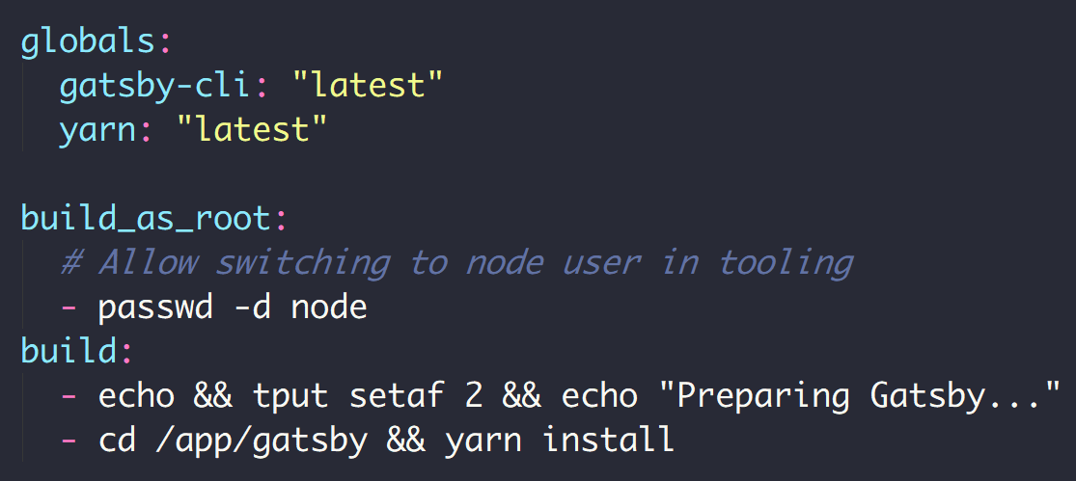
.lando.yml

Slide 14
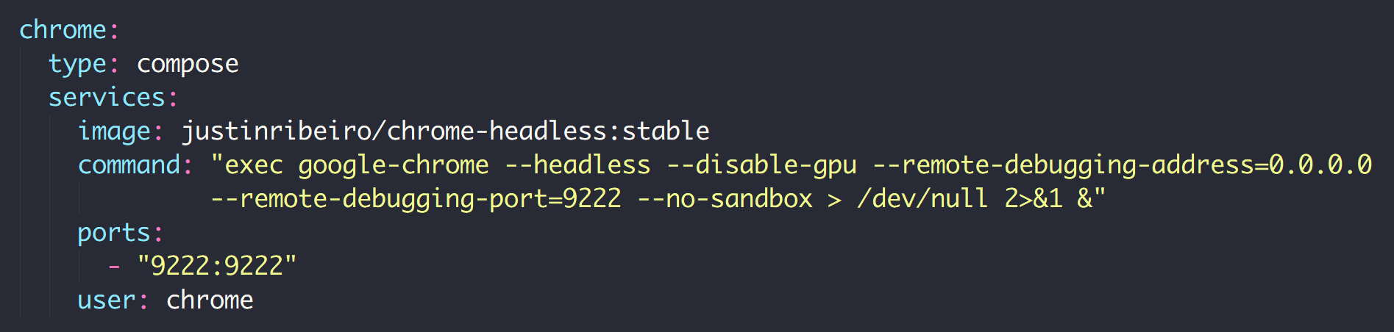
.lando.yml

Slide 15
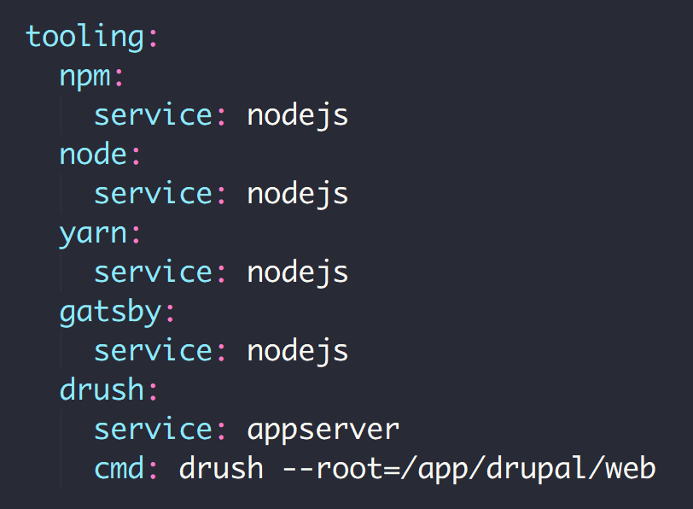
.lando.yml

Slide 16
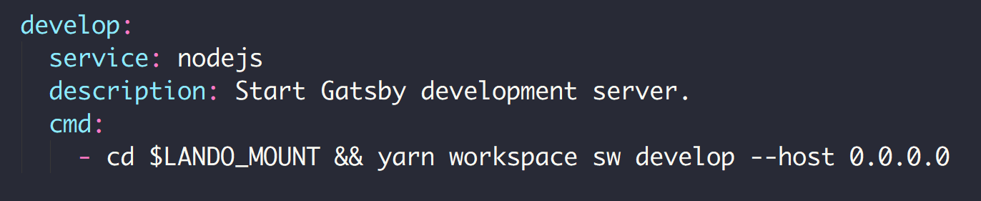
.lando.yml

Slide 17
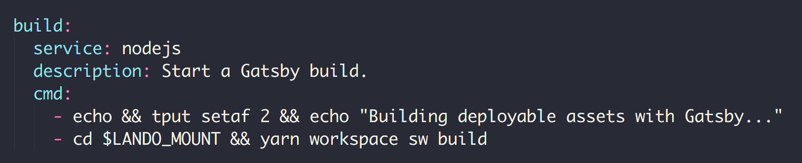
.lando.yml

Slide 18
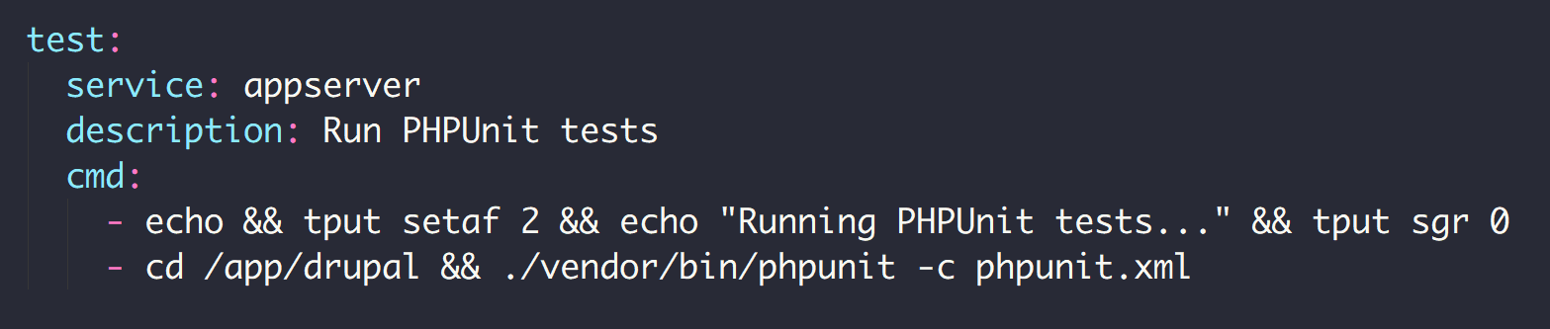
.lando.yml

Slide 19
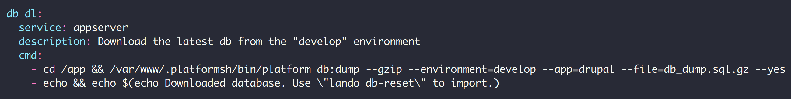
.lando.yml

Slide 20
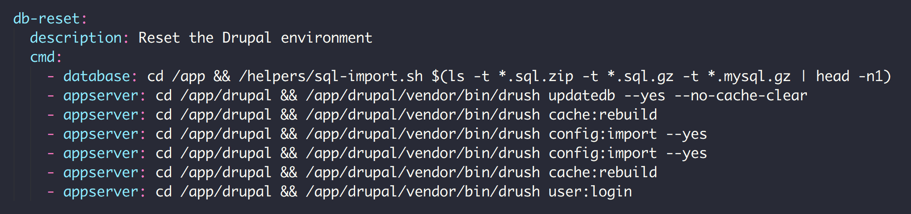
.lando.yml

Slide 21
Drupal As an App
Local-Only Installation of Drupal
Tome Module
Static Site Generator
Stores Content Statically
Publish

Slide 22
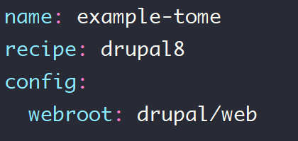
.lando.yml

Slide 23
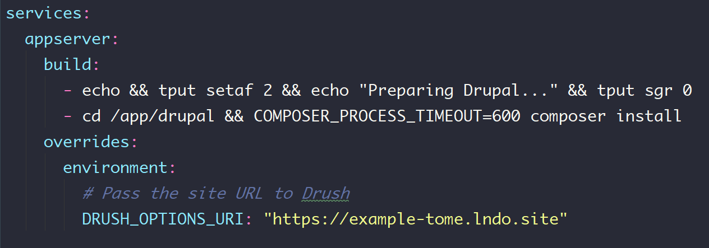
.lando.yml

Slide 24
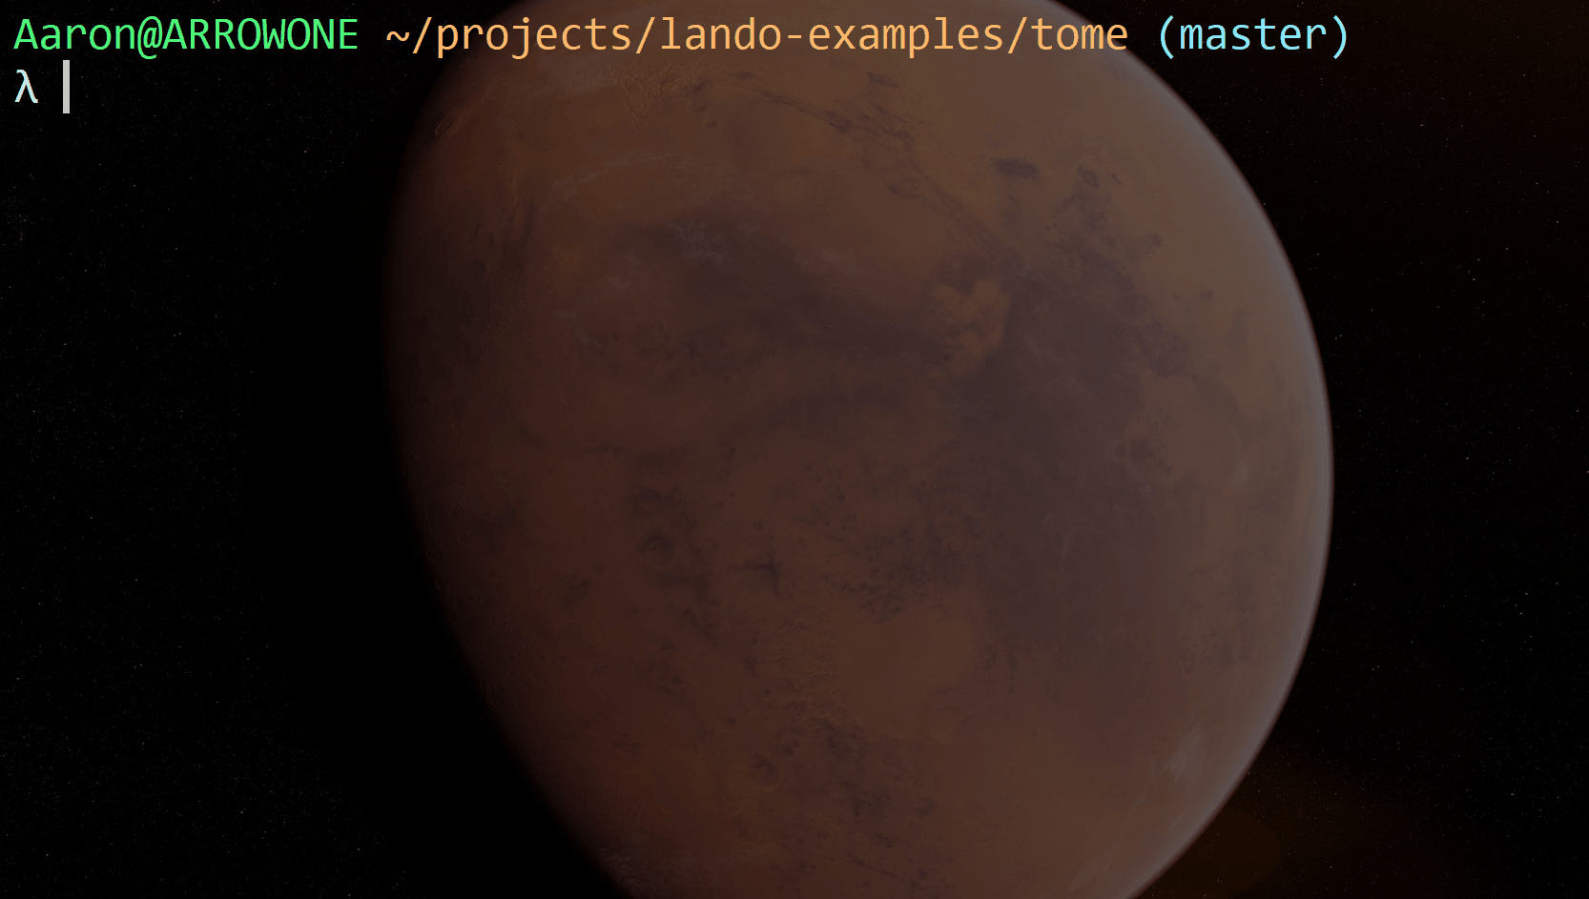

Slide 25
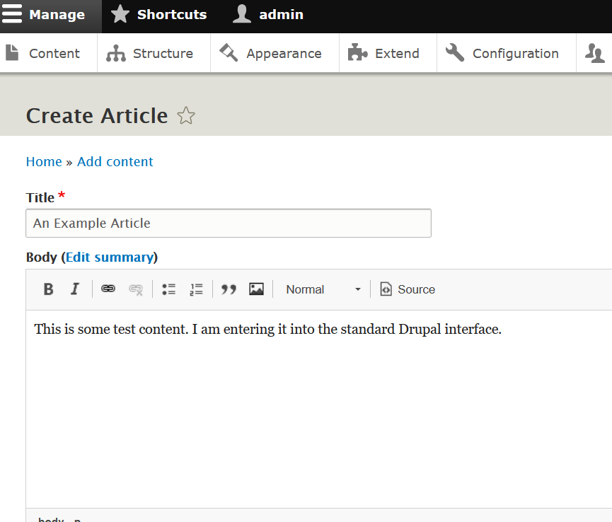

Slide 26
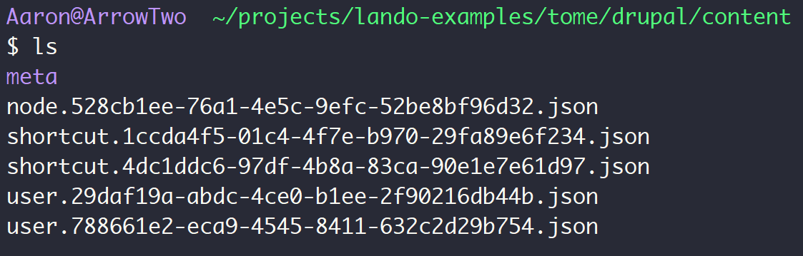
JSON

Slide 27
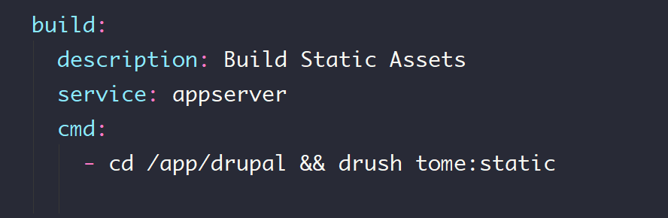
.lando.yml

Slide 28
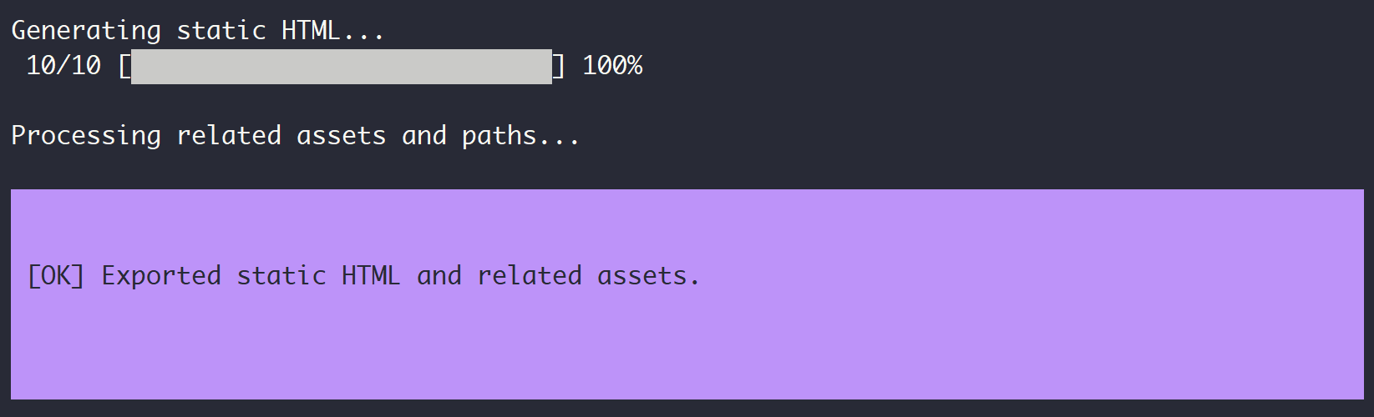
Lando Build

Slide 29
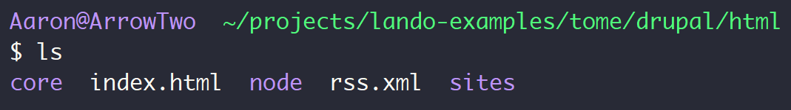
Static Assets

Slide 30
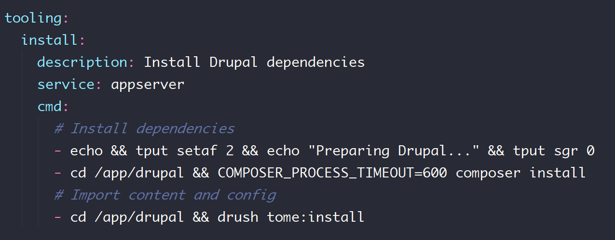
.lando.yml

Slide 31
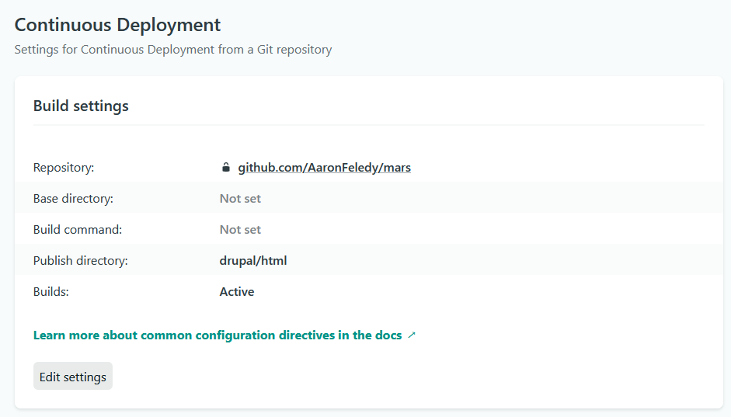
Deploy to Netlify

Slide 32
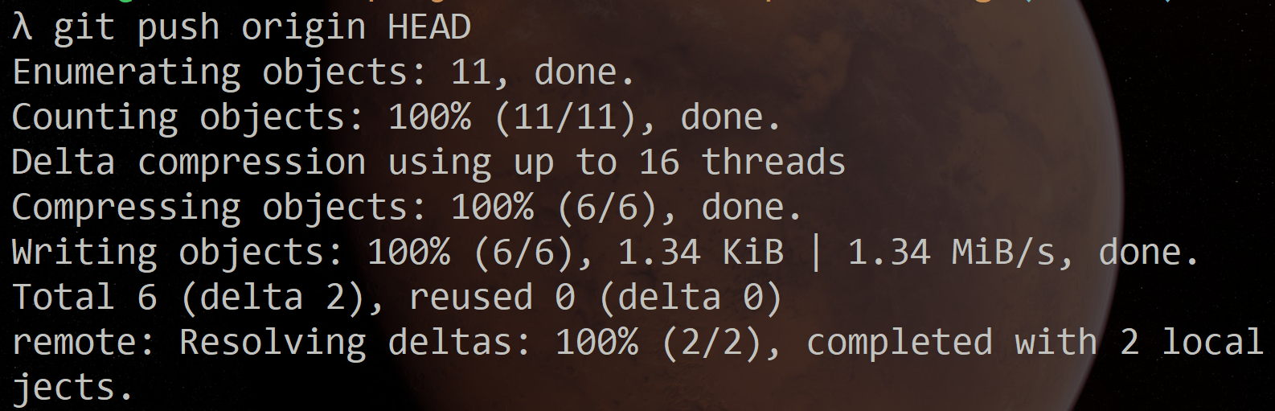
Git Push to Deploy

Slide 33
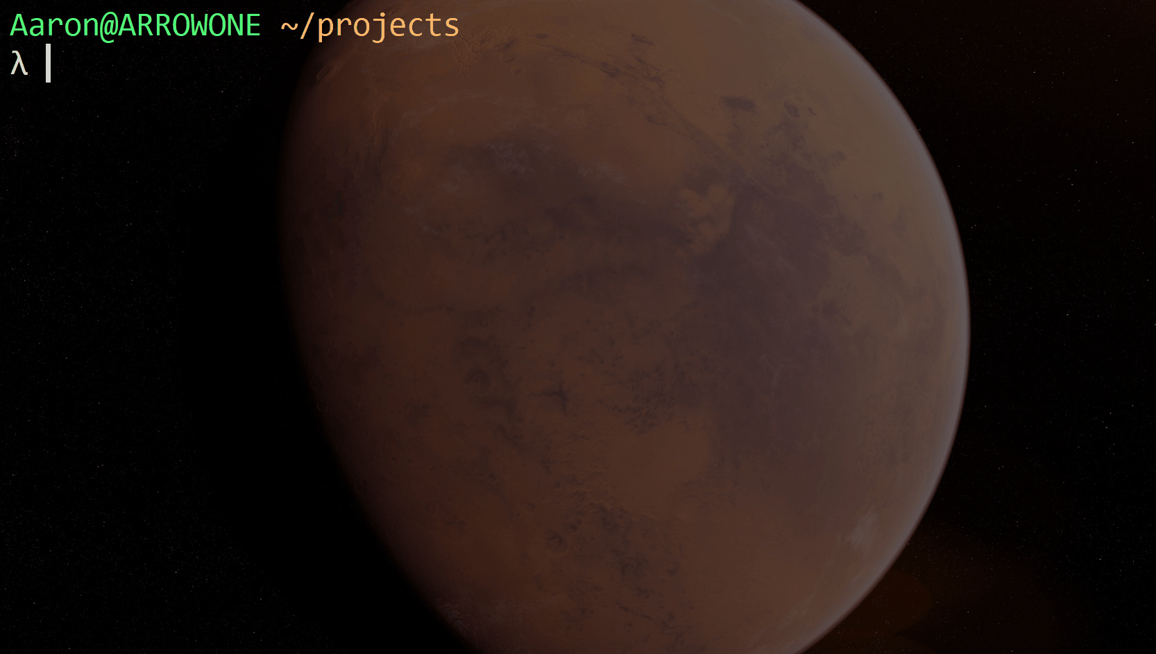

Slide 34
Links
https://github.com/AaronFeledy/lando-examples

