Slide 1
Introduction to Drupal Page Building Blocks, Paragraphs & Exp Builder Mark Colebank - NCDIT Senior Drupal Application Specialist

Slide 2
Introduction to Page Building in Drupal
About Mark & NCDIT
What are Blocks
Blocks Demo
Layout Paragraphs Demo
Experience Builder

Slide 3
NCDIT Digital Solutions
Mark Colebank
Web Developer since 1996
Federal Government Contractor
Working for NCDIT since 2020
Team Accomplishments
2014 - Digital Solutions Drupal 7 platform
NIEHS mobile redesign 2013
NTP mobile redesign in 2017
2022 NC.Gov Citizen portal redesign
Developed AWS hosted Drupal 10 multi site with minimal dependence on vendors
2018-2022 Migrated 67 sites to Drupal 8

Slide 4
What is a Block?
A block of content
Admin > CONTENT > Blocks
A Basic Block A Text FIELD

Slide 5
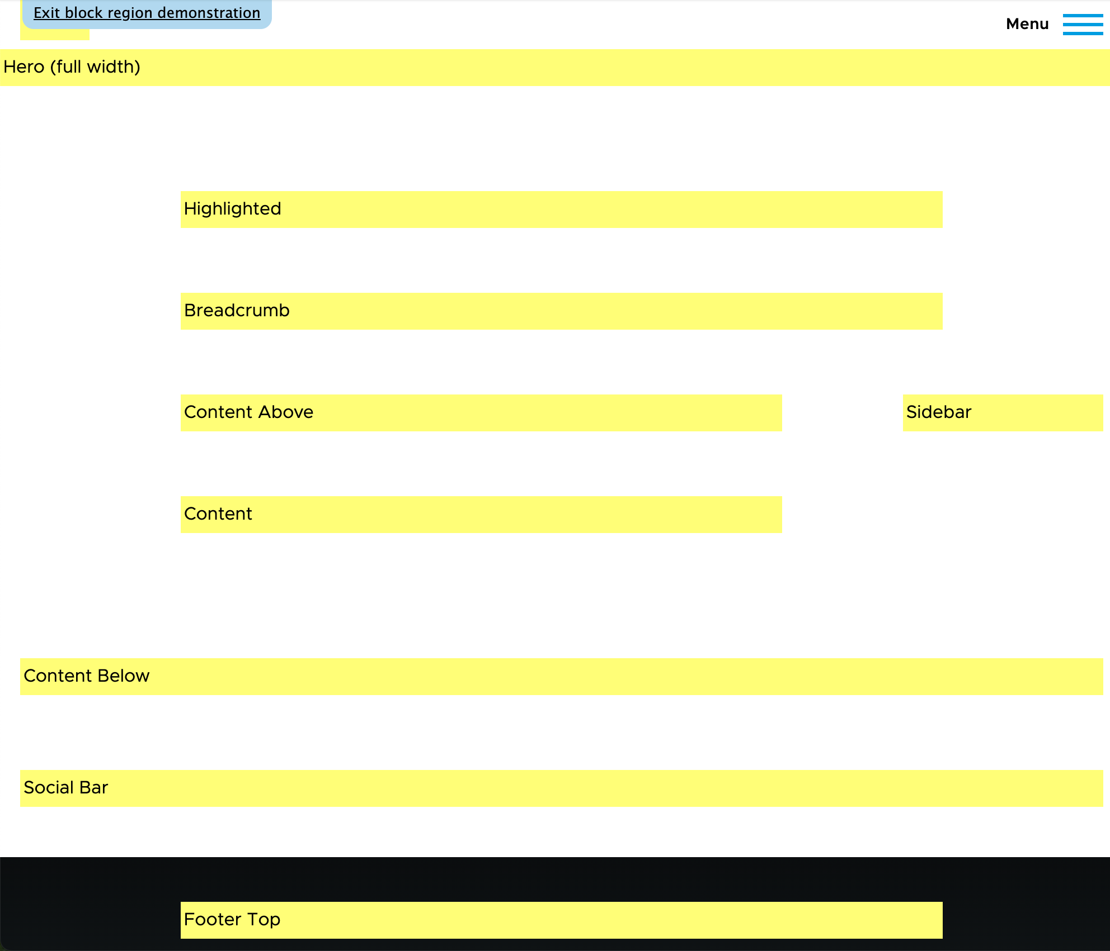
Block Regions
Blocks are individual pieces of content placed inside regions.
A theme has Regions (Header, Content, & Footer) for Blocks of content. /admin/structure/block/demo/olivero

Slide 6
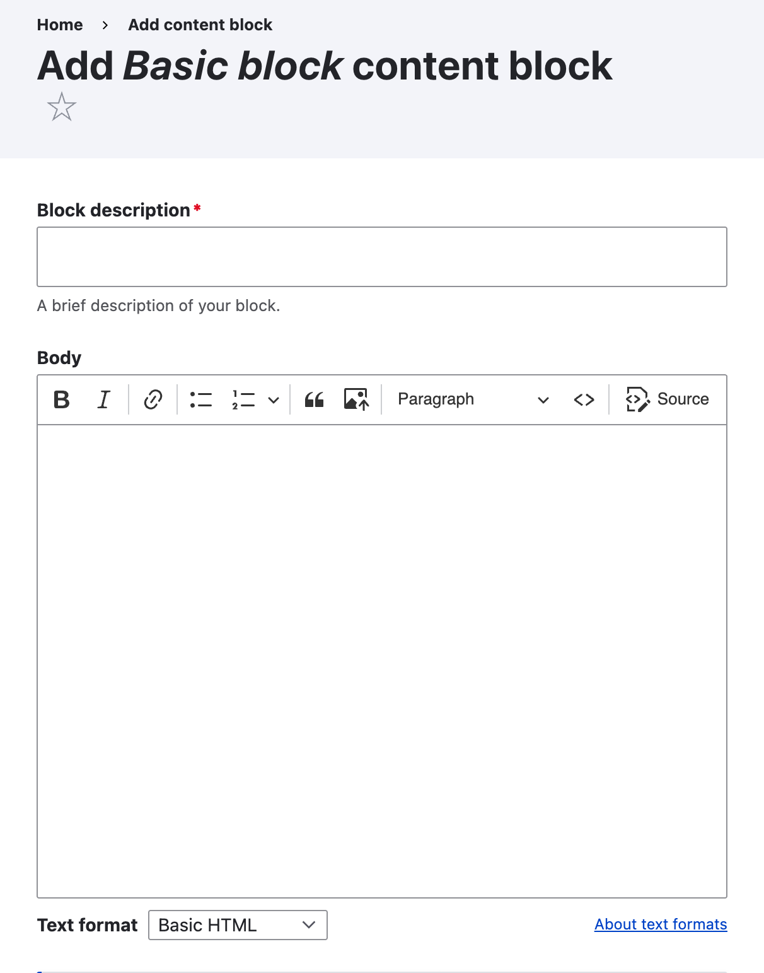
Create a Block
In Manage administrative menu, navigate to Content > Blocks
Add content block. The Add content block page appears.
/admin/content/block

Slide 7
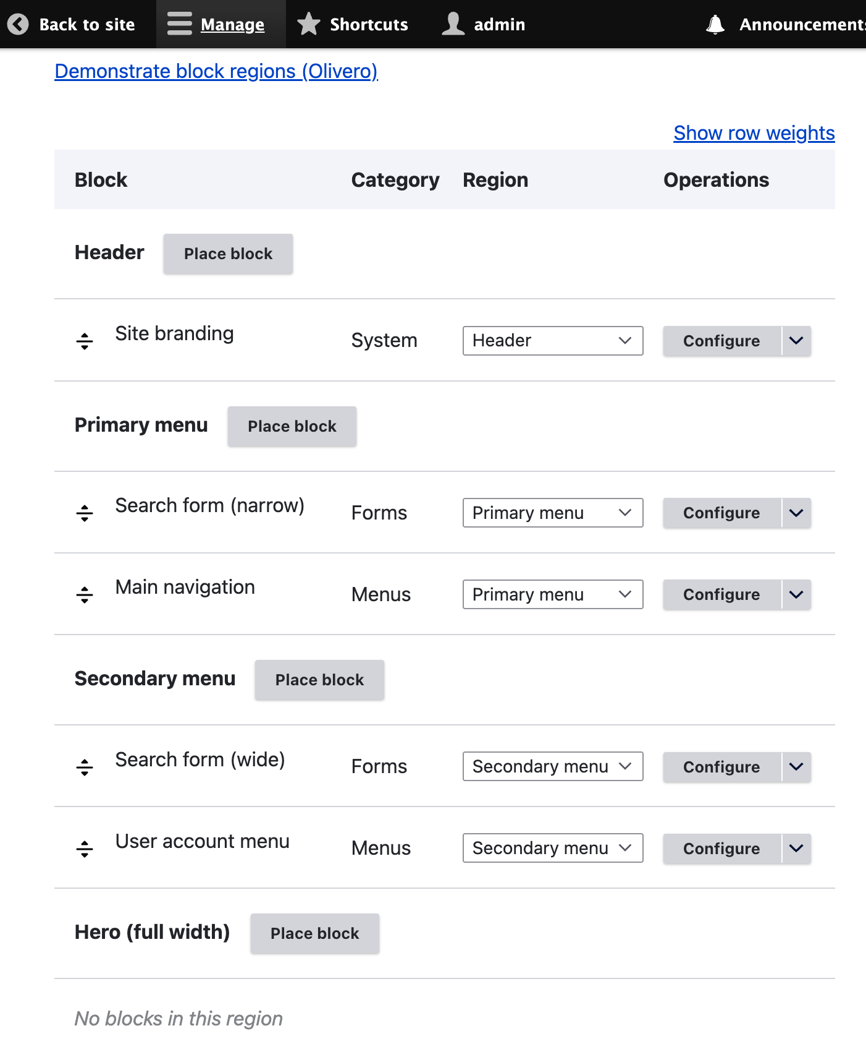
Add Block to Region
In Manage administrative menu, Structure > Block Layout
Block Layout page lists theme regions.
Locate region and click Place block.
Configure Block Settings
/admin/structure/block

Slide 8
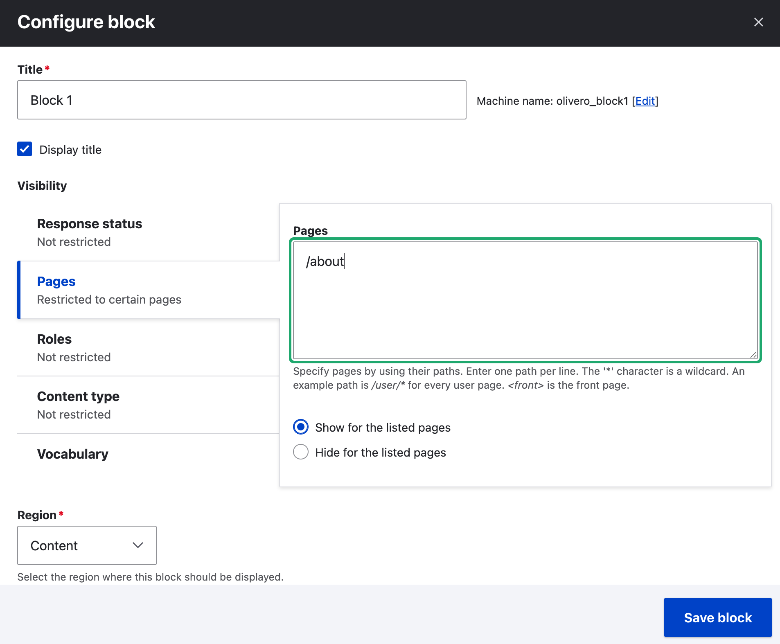
Block Configuration
You can configure how blocks are displayed
Response Status
Pages
Roles
Content Type
Vocabulary

Slide 9
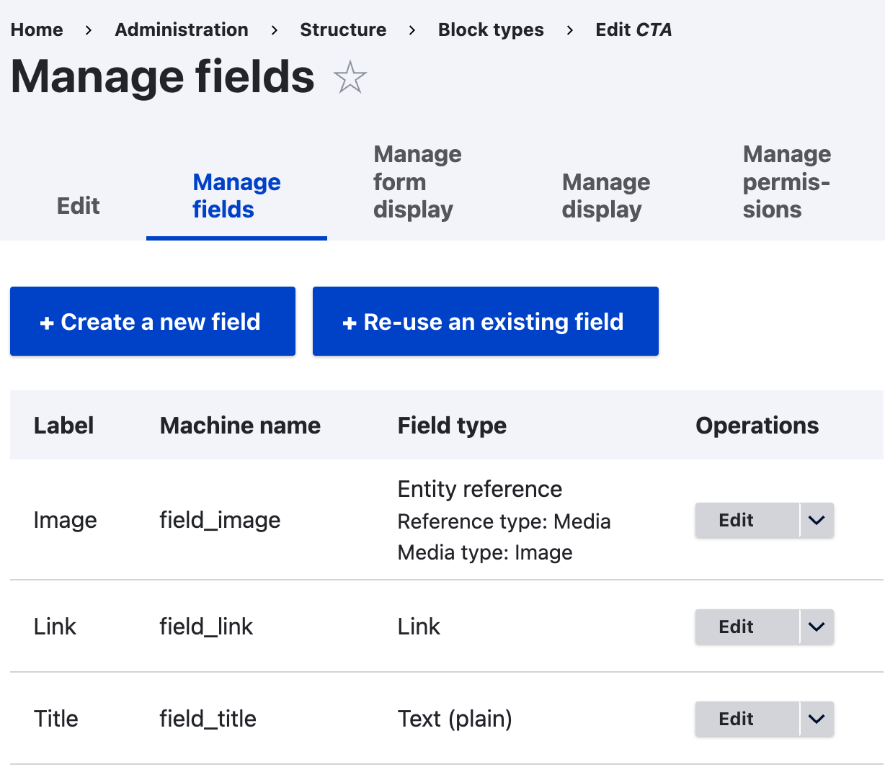
Block Types
Structure > Block Types
Block types are reusable blueprints
Add fields (text, images, etc.)
Use Manage Display to add HTML
drupal.org/project/field_group
drupal.org/project/ebt_core

Slide 10
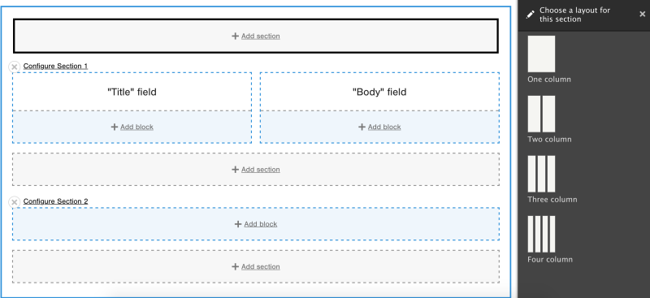
Layout Builder
Enable Layout Builder (Extend tab)
Edit a Content Type (Structure tab)
Choose Manage Display
Check Use Layout Builder
Check Allow each content item to have its layout customized.
Edit Content Item, use Layout tab
drupalize.me/tutorial/introduction-layout-builder

Slide 11
Layout Paragraphs
Only 2 Modules to Install
Paragraphs
Layout Paragraphs
Add a Paragraphs reference field to a content type.
Choose “Layout Paragraphs” under “Manage form display”
Choose “Layout Paragraphs” under “Manage display”
Create a layout section paragraph
Enable the “Layout Paragraphs”
Select layouts you want available
drupal.org/project/layout_paragraphs

Slide 12
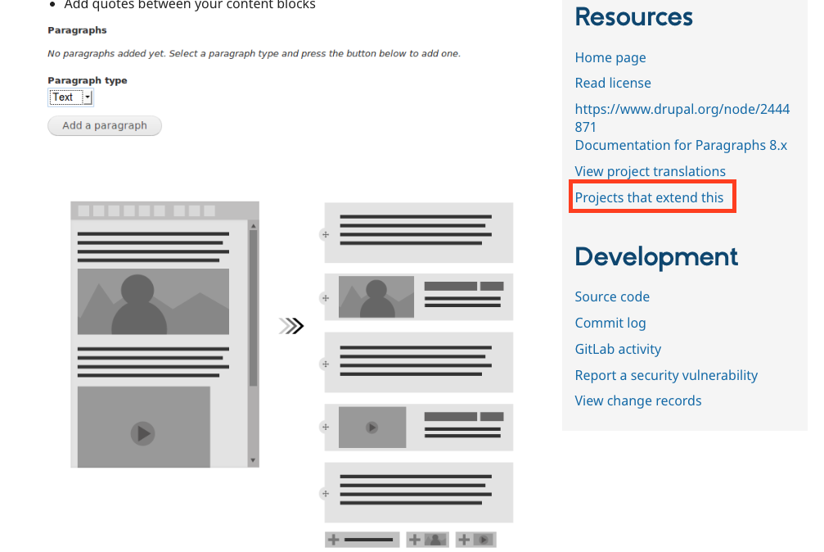
Paragraphs Modules
126 modules that expand paragraphs
Extra Paragraph Types
Install EPT Core first
drupal.org/project/paragraphs

Slide 13
Page Builder Tool Comparison
Layout Builder
Core module
Access Control
UI can be confusing
No Revisions out of box
Need many Contrib Modules (152 available)
Layout Paragraphs
More complex setup
Structured Content (all fields)
Supports Nesting
2 modules for decent UI/UX
Easier Contrib EcoSystem

Slide 14
Experience Builder
Coming 2026
Uses SDC Components and Blocks
Parallel Usability

Slide 15
Questions
COLEBANK.COM/DRUPALCAMP2025
mark@colebank.com

